Slide 1
Digital Vault
2026 Roadmap

Slide 2
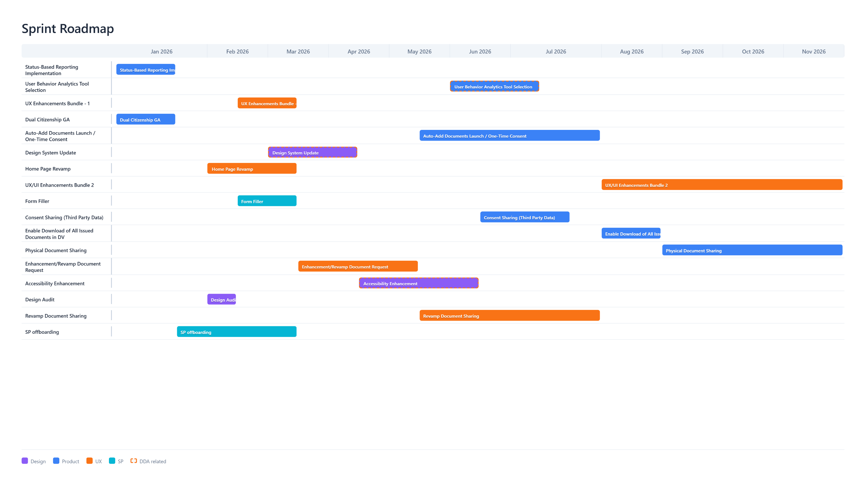
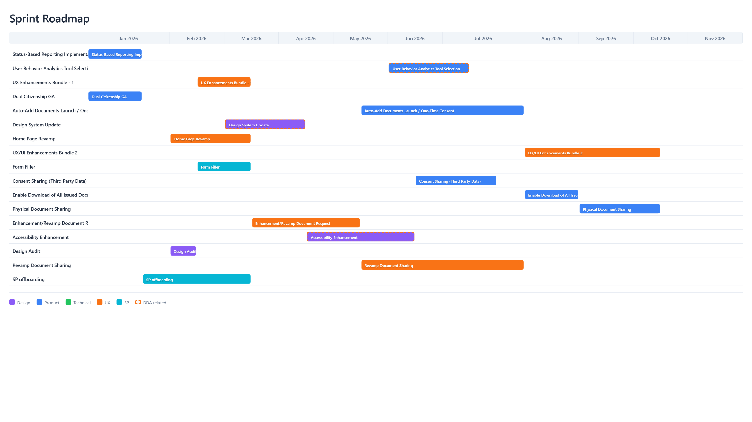

Slide 3
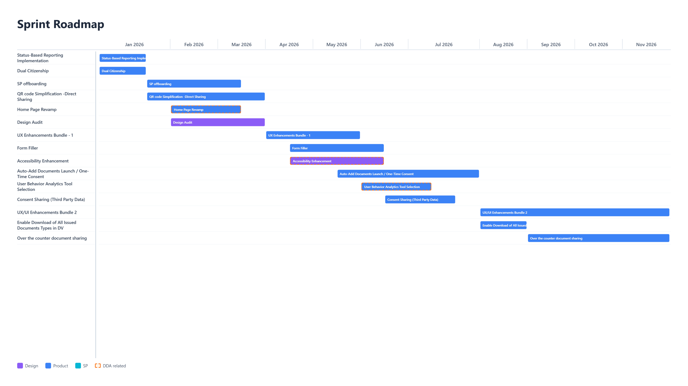

Slide 4
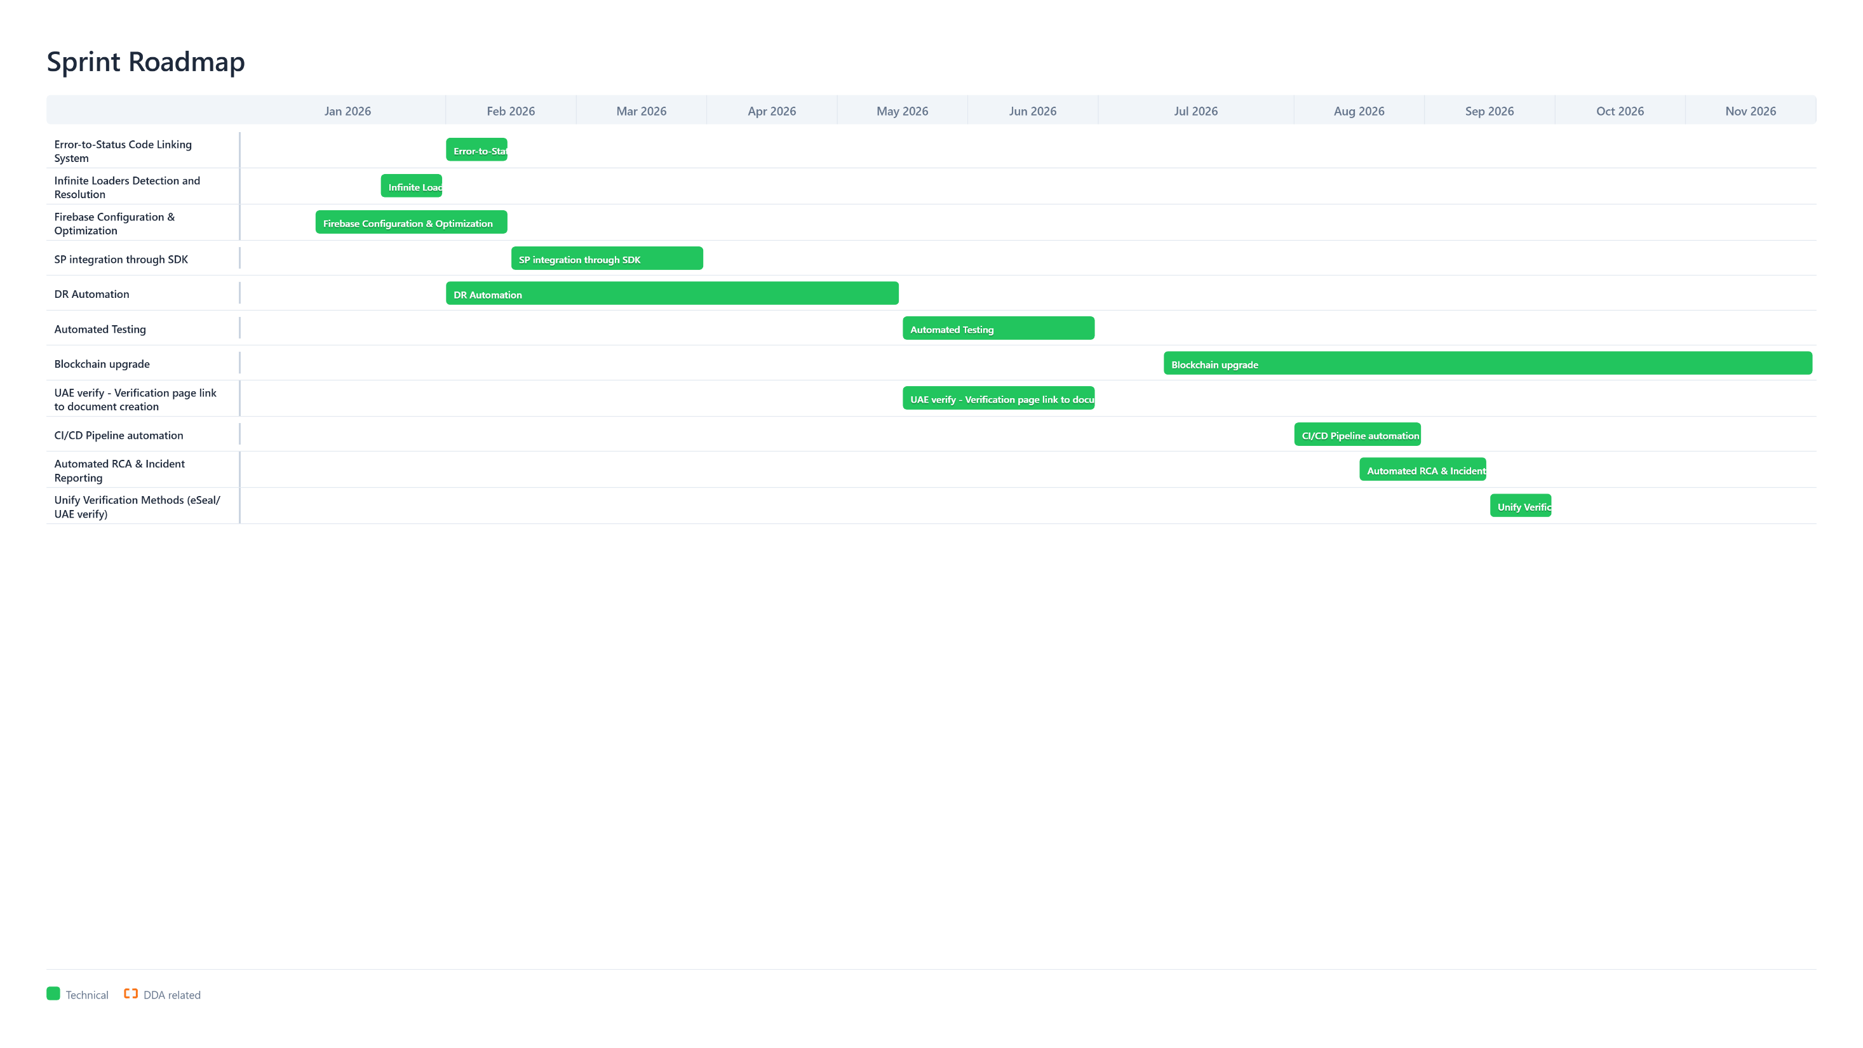

Slide 5
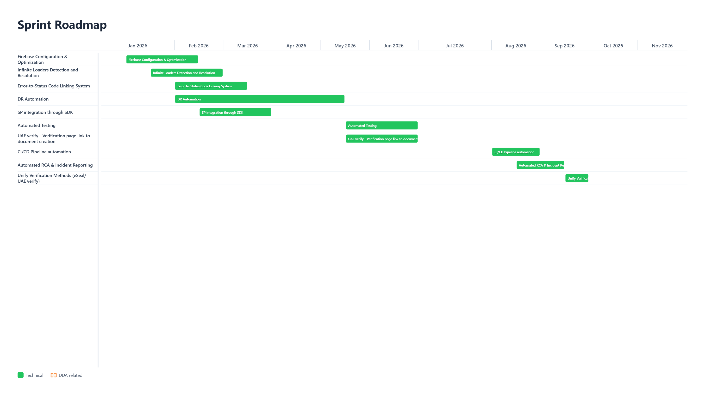

Slide 6
Dual Citizenship
Epic Name | Dual Citizenship
Objectives | • Finalize Primary/Secondary EID handling across all relevant flows. • Complete EN/AR copy approval and validate edge cases to reduce user confusion and support load. • Ensure downstream integrations behave correctly for both primary and secondary identifiers.
Description | Complete Primary/Secondary EID handling with final EN/AR copy approval and edge case handling.
Acceptance Criteria | • User can add/manage primary and secondary EID where applicable without breaking existing accounts. • All impacted screens have approved EN/AR copy. • Edge cases covered: switching primary, duplicate detection, and issuer retrieval using the correct identifier. • No increase in authentication failure rate after release (tracked for first 2 weeks).
Owners | • Product Management • Backend Development • Frontend/Mobile Development • Quality Assurance • Customer Support / Ops
Dependencies | • ICP/DDA Dual citizenship flag availability. • Backend validation rules for primary/secondary EID storage and retrieval. • Regression coverage for authentication, profile, and document flows.
Timeline | • Dates: 01 Jan 2026 – 28 Jan 2026 • Sprints: 71–72 • Priority/Complexity: High/Medium
Target Audience | • UAE PASS users • Support & Operations teams

Slide 7
Status-Based Reporting Implementation
Epic Name | Status-Based Reporting Implementation
Objectives | • Introduce a consistent 23-status-code model for sharing requests so we can measure success/failure end-to-end. • Store status transition history (previous status + timestamp) to enable journey analysis and operational reporting. • Provide initial dashboards/reports that answer: volume, success rate, drop-off points, and top failure reasons.
Description | Implement a consistent status model and status history for sharing requests to enable end-to-end reporting, diagnostics, and analytics.
Acceptance Criteria | • Every sharing request is assigned exactly one current status from the agreed set. • All status changes are persisted with timestamps and previous status. • At least 3 core reports are available: overall success rate, drop-off by status, and top failure/error categories. • Support team can map a user case to its latest status using a request identifier.
Owners | • Product Management • Backend Development • Frontend/Mobile Development • Quality Assurance • Customer Support / Ops
Dependencies | • Agreement on the canonical status model and definitions (product + support). • Database schema update to store status transitions and history. • Instrumentation updates in backend services and clients to emit status transitions. • Report consumer (dashboard / export) decision and access control.
Timeline | • Dates: 01 Jan 2026 – 28 Jan 2026 • Sprints: 71–72 • Priority/Complexity: High/Medium
Target Audience | • UAE PASS users • Service Providers • Support & Operations teams • Product & Analytics stakeholders

Slide 8
SP offboarding
Epic Name | SP offboarding
Objectives | • Provide a controlled way to offboard Service Providers without breaking active user journeys. • Remove stale integrations and reduce operational burden.
Description | To create a process for offboarding Already onboarded Service providers. With the option of re-onboarding.
Acceptance Criteria | • Provider can be disabled via configuration without a new app release (where possible). • Offboarding is logged and auditable (who/when/why). • No critical errors caused by disabled providers in production.
Owners | • Service Provider Onboarding team • Product Management • Backend Development • Frontend/Mobile Development • Quality Assurance
Dependencies | • Inventory of active Service Providers and their integration method. • Backend flags/config to disable providers safely (with rollback). • Support playbook and communications plan for affected providers/users.
Timeline | • Dates: 29 Jan 2026 – 25 Mar 2026 • Sprints: 73–76 • Priority/Complexity: Medium/Medium
Target Audience | • UAE PASS users • Service Providers • Support & Operations teams

Slide 9
Home Page Revamp
Epic Name | Home Page Revamp
Objectives | • Redesign the DV home page to surface the most-used actions and recent items immediately. • Reduce time-to-task for frequent journeys (share, request). • Improve engagement by making status, alerts, and shortcuts visible and consistent.
Description | Redesign the DV home page to prioritize top tasks and reduce navigation friction.
Acceptance Criteria | • Home page highlights 3–5 primary actions and recent/important items without scrolling on common devices. • Users can reach top tasks within 1–2 taps from home. • Analytics events added for key home interactions (cards, shortcuts).
Owners | • Product Design (UX/UI) • Product Management • Frontend/Mobile Development • Quality Assurance
Dependencies | • Agreement on the primary jobs-to-be-done for the home screen. • Analytics baseline for current home usage and drop-offs. • Design system update alignment (components, spacing, typography).
Timeline | • Dates: 12 Feb 2026 – 25 Mar 2026 • Sprints: 74–76 • Priority/Complexity: High/Medium
Target Audience | • UAE PASS users

Slide 10
Form Filler
Epic Name | Form Filler
Objectives | • Auto-fill Service Provider forms using existing document data to reduce manual typing. • Support user review and edit before submission to avoid incorrect data. • Improve completion rate for forms by reducing time and errors.
Description | Auto-fill forms using stored document data to streamline user workflows. Note: Service Provider related
Acceptance Criteria | • Field mapping is versioned so form changes do not silently break auto-fill. • Metrics tracked: time-to-complete and form submission success rate.
Owners | • Service Provider Enablement/Partnerships • Product Management • Backend Development • Frontend/Mobile Development • Quality Assurance
Dependencies | • Mapping between DV document fields and Service Provider form fields. • Consent and data-sharing rules for populating third-party forms. • SDK or integration method for Service Providers to adopt the feature.
Timeline | • Dates: 23 Apr 2026 – 17 Jul 2026 • Sprints: 79–82 • Priority/Complexity: High/Low
Target Audience | • UAE PASS users • Service Providers (form owners)

Slide 11
UX Enhancements Bundle - 1
Epic Name | UX Enhancements Bundle - 1
Objectives | • Improve the documents list view so users can find, filter, and act on documents faster. • Reduce cognitive load by clarifying document status, issuer, and last update at a glance. • Support common actions directly from the list (view, share, download) with fewer taps.
Description | This is a place holder item to implement the outcomes of design audit and Design system epics.
Acceptance Criteria | TBD
Owners | • Product Design (UX/UI) • Product Management • Frontend/Mobile Development • Quality Assurance
Dependencies | • Analytics/funnel data to prioritize list pain points (filter usage, search behavior). • Design system components availability and alignment. • Backend APIs support for filtering/sorting (if not already available).
Timeline | • Dates: 26 Feb 2026 – 25 Mar 2026 • Sprints: 75–76 • Priority/Complexity: High/Medium
Target Audience | • UAE PASS users

Slide 12
Document Request Revision
Epic Name | Document Request Revision
Objectives | • Redesign the document request flow so users understand what is being requested and why. • Reduce request abandonment by simplifying steps and clarifying expected outcomes. • Improve request success rate and reduce support escalations.
Description | Redesign the document request journey with clearer steps, better copy, and trackable outcomes aligned to the status model.
Acceptance Criteria | • Request flow has clear steps: select provider/context → confirm scope → send → track outcome. • User can track request status using the status model (e.g., sent, viewed, completed, failed). • Error states include actionable recovery steps (retry, contact support, change provider). • A/B or usability review indicates improved comprehension vs current flow.
Owners | • Product Design (UX/UI) • Product Management • Frontend/Mobile Development • Quality Assurance
Dependencies | • Service Provider requirements for request payload and response handling. • Copywriting in EN/AR for key request states and error handling. • Status model alignment so request states map cleanly to reporting.
Timeline | • Dates: 26 Mar 2026 – 20 May 2026 • Sprints: 77–80 • Priority/Complexity: High/Medium
Target Audience | • UAE PASS users • Service Providers

Slide 13
Auto-Add Documents Launch / One-Time Consent
Epic Name | Auto-Add Documents Launch / One-Time Consent
Objectives | • Introduce one-time consent allowing DV to periodically check for new/updated issued documents. • Auto-add eligible documents to the user’s vault with clear visibility and control. • Reduce manual steps for users who frequently receive updated documents.
Description | One-time consent for DV to periodically check and auto-add new/updated documents from issuers. Note: Pending Legal TDRA approval
Acceptance Criteria | • User can grant one-time consent and review what it enables (scope, frequency, revocation). • System can detect and auto-add new/updated documents from participating issuers. • User is notified (in-app and/or push) when a document is added/updated, with a link to view details. • User can revoke consent and stop further checks; revocation takes effect within the stated window.
Owners | • Product Management • Backend Development • Frontend/Mobile Development • Quality Assurance • Customer Support / Ops • Legal/Compliance (approval gates)
Dependencies | • Legal/TDRA approval for consent language and periodic checks (noted as a gate). • Issuer availability and rules for which documents can be auto-added. • Notification/UX design for new document events and opt-out controls.
Timeline | • Dates: 21 May 2026 – 12 Aug 2026 • Sprints: 81–86 • Priority/Complexity: High/Low
Target Audience | • UAE PASS users • Participating issuers / Service Providers • Legal & Compliance

Slide 14
Document Sharing Revision
Epic Name | Document Sharing Revision
Objectives | • Redesign the sharing flow to increase successful shares and reduce retries. • Make selection, consent, and confirmation steps obvious and lightweight. • Improve failure recovery: clear reasons, next steps, and support hooks.
Description | Revamp the sharing flow across selection, consent, confirmation, and failure recovery, tied to status-based reporting for measurable improvements.
Acceptance Criteria | • Share flow supports: select document(s) → select recipient/provider → confirm scope/consent → share → track result. • Failures show the mapped status/error category and a recommended action (retry, switch channel, contact support). • Share success rate baseline established and post-release tracked. • Support can diagnose a failed share using request ID and status history.
Owners | • Product Design (UX/UI) • Product Management • Frontend/Mobile Development • Quality Assurance
Dependencies | • Status-based reporting to identify top failure states and where users drop off. • Design system components for consistent share UI patterns. • Backend support for retry-safe operations and better error messages.
Timeline | • Dates: 21 May 2026 – 12 Aug 2026 • Sprints: 81–86 • Priority/Complexity: High/Medium
Target Audience | • UAE PASS users • Service Providers • Support teams

Slide 15
User Behavior Analytics Tool Selection (DDA Dependent)
Epic Name | User Behavior Analytics Tool Selection
Objectives | • Select a user-behavior analytics tool that supports session replay and key funnels for DV journeys. • Instrument core flows to measure drop-offs and time-to-complete (home → select doc → share/request). • Enable Real User Monitoring (RUM) signals to correlate performance issues with user impact.
Description | Select and integrate analytics tool (UXCam/Firebase Analytics) to enable data-driven optimization, session replay, and Real User Monitoring (RUM) for user behavior patterns. Relates to: 1
Acceptance Criteria | • Tool decision documented with reasons (capabilities, cost, privacy/security, integration effort). • Event taxonomy defined for at least 10 key events + 3 funnels. • Dashboards show funnel conversion + top screens with rage taps/crashes/performance issues. • Session replay is enabled for approved users with PII masking rules.
Owners | • Product Management • Backend Development • Frontend/Mobile Development • Quality Assurance • Customer Support / Ops
Dependencies | • Security, privacy, and data retention review for candidate tools (e.g., Firebase Analytics vs UXCam). • Mobile app instrumentation plan and event taxonomy aligned to the status model. • Access model for who can view session replays (PII considerations).
Timeline | • Dates: 04 Jun 2026 – 15 Jul 2026 • Sprints: 82–84 • Priority/Complexity: High/Medium
Target Audience | • UAE PASS users • Service Providers • Support & Operations teams • Product, UX, Engineering leads

Slide 16
Consent Sharing (Third Party Data)
Epic Name | Consent Sharing (Third Party Data)
Objectives | • Enable sharing of third-party data through an explicit, user-controlled consent mechanism. • Standardize consent capture (who, what, why, duration) to support audits and user trust. • Support downstream APIs to verify consent before data is shared.
Description | Sharing third party data via providing consent mechanism.
Acceptance Criteria | • Before any third-party data is shared, the user is shown scope + purpose and must confirm. • Consents are stored with timestamp, requester identity, scope, and expiry (if applicable). • User can view and revoke active consents. • APIs enforce consent checks and log consent reference IDs for audit.
Owners | • Product Management • Backend Development • Frontend/Mobile Development • Quality Assurance • Customer Support / Ops • Legal/Compliance (approval gates)
Dependencies | • Consent model definition (data fields, TTL/expiry, revocation) and storage. • UX patterns for clear disclosure and granular selection where needed. • Legal/compliance review for consent wording and audit requirements.
Timeline | • Dates: 18 Jun 2026 – 29 Jul 2026 • Sprints: 83–85 • Priority/Complexity: High/High
Target Audience | • UAE PASS users • Service Providers requesting third-party data • Legal & Compliance • Audit/Operations

Slide 17
Enable Download of All Issued Documents in DV
Epic Name | Enable Download of All Issued Documents Types in DV
Objectives | • Allow users to download all issued documents available in DV. • Reduce friction for users who need offline copies for personal record-keeping or external submissions. • Ensure downloads respect issuer rules and user entitlements.
Description | Enable downloading all issued documents in DV
Acceptance Criteria | • Enable the download of all the visualization based documents in Digital Vault.
Owners | • Product Management • Backend Development • Frontend/Mobile Development • Quality Assurance • Customer Support / Ops
Dependencies | • Backend support for bulk selection and secure file packaging • Rate limiting and security controls to prevent abuse.
Timeline | • Dates: 13 Aug 2026 – 09 Sep 2026 • Sprints: 87–88 • Priority/Complexity: High/Low
Target Audience | • UAE PASS users • Support & Operations teams

Slide 18
UX/UI Enhancements Bundle 2
Epic Name | UX/UI Enhancements Bundle 2
Objectives | • Deliver the second bundle of UI/UX improvements based on feedback and observed behavior. • Address the top 3 usability issues discovered after analytics tooling is in place.
Description | Second bundle of UI/UX improvements based on design audit, design system update and accessibility findings
Acceptance Criteria | TBD
Owners | • Product Design (UX/UI) • Product Management • Frontend/Mobile Development • Quality Assurance
Dependencies | Design Audit Design System Update Accessibility Reports
Timeline | • Dates: 13 Aug 2026 – 3 Dec 2026 • Sprints: 87–94 • Priority/Complexity: High/Medium
Target Audience | • UAE PASS users

Slide 19
Design Audit
Epic Name | Design Audit
Objectives | • Review core screens and journeys and capture pain points with evidence (screenshots, examples). • Identify quick wins vs larger redesign candidates and propose sequencing. • Align priorities with Product and Engineering so the backlog is implementation-ready.
Description | UI/UX designer reviews the current screens to identify room for improvement and the biggest pain points (usability, clarity, consistency). Output is a prioritized backlog with recommended fixes.
Acceptance Criteria | • Audit report delivered with issues grouped by severity/impact and linked to screens. • Prioritized improvement backlog created (with effort sizing placeholders). • Top quick wins have clear specs and acceptance criteria ready for development.
Owners | • Product Design (UX/UI) • Product Management • Frontend/Mobile Development • Quality Assurance
Dependencies | • Agreed scope of screens/flows to audit. • Access to current designs/build, and top support ticket themes (if available). • Review workshop with key stakeholders to finalize priorities.
Timeline | Dates: 12 Feb 2026 – 08 Apr 2026 | Sprints: 74–77 | Priority/Complexity: High/Low
Target Audience | • UAE PASS users

Slide 20
Design System Update (DDA Dependent)
Epic Name | Design System Update (DDA Dependent)
Objectives | Design System Update
Description | • Update and enhance the DV design system components and patterns based on current product needs. • Align DV and DDA design standards where applicable to reduce divergence. • Improve implementation consistency by publishing clear guidelines and reusable assets.
Acceptance Criteria | Joint effort with the DDA UI/UX team to update and enhance the DV design system so it stays up to date and supports consistent implementation across teams.
Owners | • Updated design system published with versioning and change log. • High-usage components are standardized and adopted in the app. • New work uses updated components; legacy screens have a migration plan.
Dependencies | • Product Design (UX/UI) • DDA UX/UI Team (joint) • Product Management • Frontend/Mobile Development • Quality Assurance
Timeline | • Regular working sessions with DDA UI/UX team and agreement on standards. • Component inventory and gap analysis (what exists vs what’s missing). • Engineering adoption plan for component library updates and migration.
Target Audience | Dates: 12 Mar 2026 – 22 Apr 2026 | Sprints: 76–78 | Priority/Complexity: High/Medium

Slide 21
Accessibility Enhancement (DDA Dependent)
Epic Name | Accessibility Enhancement
Objectives | Accessibility Enhancement
Description | • Improve accessibility compliance across priority screens and critical flows. • Embed accessibility checks into design, development, and QA so issues don’t regress. • Reduce accessibility-related user friction and support cases.
Acceptance Criteria | Increase the level of accessibility support in the app across key DV screens and flows (screen reader, contrast, dynamic text, focus order, touch targets) and validate against an agreed WCAG target.
Owners | • Priority flows meet the agreed accessibility checklist (labels, focus, scaling, contrast). • Accessibility checklist is added to QA and release criteria. • Remaining gaps are documented with owners and a mitigation plan.
Dependencies | • Product Design (UX/UI) • Product Management • Frontend/Mobile Development • Quality Assurance
Timeline | • Define target WCAG level and priority flows in scope. • Accessibility guidelines for designers and developers (components + content). • Testing approach (manual + automated) for iOS/Android.
Target Audience | Dates: 23 Apr 2026 – 17 Jun 2026 | Sprints: 79–82 | Priority/Complexity: High/High

Slide 22
Over the counter Document Sharing
Epic Name | Over the counter Document Sharing
Objectives | • Enable sharing of documents over the counter through UAE PASS.
Description | Enable sharing of Digital Vault documents Over the counter.
Acceptance Criteria | TBD
Owners | • Product Management • Backend Development • Frontend/Mobile Development • Quality Assurance • Customer Support / Ops
Dependencies | • Definition of 'verified copy' workflow and acceptable document types. • Service Provider acceptance format and validation requirements.
Timeline | • Dates: 10 Sep 2026 – 3 Dec 2026 • Sprints: 89–94 • Priority/Complexity: High/High
Target Audience | • UAE PASS users • Service Providers

Slide 23
QR code simplification – Direct sharing
Epic Name | QR code simplification – Direct sharing
Objectives | Adress SP feedback on the difficulty of scanning the current QR codes. Simplify the UX/UI for sharing Make it easier for SPs to integration the document sharing functionality
Description | Simplify the QR code generation logic and introduce a new way to trigger the sharing requests to the user from the SP channel.
Acceptance Criteria | TBD
Owners | • Product Management • Backend Development • Frontend/Mobile Development • Quality Assurance • Customer Support / Ops
Dependencies | • DDA exposure of UDID identification services from email or mobile number or Eid. • Existing integrations with Service providers
Timeline | • Dates: 29 Jan 2026 – 08 Apr 2026 • Sprints: 73–77 • Priority/Complexity: High/Med
Target Audience | • UAE PASS users • Service Providers

Slide 24
UAEVerify SEO
Objectives | • To implement the SEO for the UAEVerify portal
Description | Need to improve the SEO of the UAEVerify website by adding proper SEO metadata across key pages so the site can rank better in Google search results. This includes adding page-level meta tags and structured information that helps search engines understand the content and display rich previews.
Acceptance Criteria | • The improved rank for UAEVerify website in google search, ideally it should appear at the top • Meta data per page is as per approved copy.
Owners | • Service Provider Enablement/Partnerships • Product Management • Backend Development • Frontend/Mobile Development • Quality Assurance
Dependencies | • Google algorithm takes its time to improve the
Timeline | • Dates: 30 Jan 2026 – 10 Feb 2026 • Sprints: 73
Target Audience | • UAE PASS users • Service Providers (form owners)

Slide 25
Error to status code linking
Objectives | • To create the operational dashboard to track the state of the sharing request using the latest status model.
Description | Auto-fill forms using stored document data to streamline user workflows. Note: Service Provider related
Acceptance Criteria | • Should be able to track the sharing request using ID • To track the respective state for the sharing request • Updated funnel chart
Owners | • Service Provider Enablement/Partnerships • Product Management • Backend Development • Frontend/Mobile Development • Quality Assurance
Dependencies | • The data should be present in production as agreed format, there might be some updates required to optimise the visualisation at DB side
Timeline | • Dates: 12 Feb 2026 – 15 March 2026 • Sprints: Sprint 74- Sprint 76 • Priority/Complexity: High/Low
Target Audience | • UAE PASS users • Service Providers (form owners)

Slide 26
Infinite loader detection and resolution
Objectives | • Detect and resolve infinite loading states across the application.
Description | Issuer list Download and Share QR verification Notification list actionable and non actionable notification details document selection screen include above remaining scenarios
Acceptance Criteria | • Reduction of the loader
Owners | • Product Management • Backend Development • Frontend/Mobile Development • Quality Assurance
Dependencies
Timeline | • Dates: 31 Jan 2025 – 11 Mar 2026 • Sprints: 71-75 • Priority/Complexity: High/Low
Target Audience | • UAE PASS users • Service Providers (form owners)

Slide 27
Firebase configuration and optimization
Objectives | • To create the TTL based document deletion • Timely deletion of the anonymous users
Description | After the incident of the 6th December, we have stopped the batch processes. These batch processor was taking care of deletion of the documents from the collection and deleting the anonymous users. So now, as we are not having a batch processor running, we need TTL-based document deletion and Google Function based scheduled deletion of the anonymous users.
Acceptance Criteria | • The collection should have latest docment as per the configuration all older documents should be deleted form the firebase
Owners | • Service Provider Enablement/Partnerships • Product Management • Backend Development • Frontend/Mobile Development • Quality Assurance
Dependencies | • Google cloud
Timeline | • Dates: 15 Jan 2026 – 15 mar 2026 • Sprints: • Priority/Complexity: High/Low
Target Audience | • UAE PASS users • Service Providers (form owners)

Slide 28
Service provides SDK
Objectives | • To create the software development (SDK) kit for the SPs, this will improve the implementation time for SPs.
Description | To create the software development kit for the service providers, it will be for Android and iOS app development. SDK will have all the API implementation which is required for D-Week. It will be easy to integrate where they just need to change the configuration.
Acceptance Criteria | • easy to integrate setup for app development
Owners | • Service Provider Enablement/Partnerships • Product Management • Backend Development • Frontend/Mobile Development • Quality Assurance
Dependencies | • iOS and Android development process SPs are following
Timeline | • Dates: 1 Apr 2026 – 30 May 2026 • Sprints: • Priority/Complexity: High/Low
Target Audience | • UAE PASS users • Service Providers (form owners)

Slide 29
DR Automation
Objectives | • To prepare for the automated DR drill which would happen mid this Year
Description | • To create scripts for making apps live in one environment (DR) and stop in other (PROD) • Script to swich the primary DB • Script based traffic switching
Acceptance Criteria | • to complete the DR under 20 min
Owners | • Service Provider Enablement/Partnerships • Product Management • Backend Development • Frontend/Mobile Development • Quality Assurance
Dependencies | • FEDNET
Timeline | • Dates: 15 Mar 2026 – 30 June 2026 • Sprints: • Priority/Complexity: High/Low
Target Audience | • UAE PASS users • Service Providers (form owners)

Slide 30
SP Automation testing suite
Objectives | • To create the automation testing suite for the SPs
Description | As like the SDK to make the development faster, so this testing suite will complement the development. After completion of the development, if we have a set of Set of testing activities will be automated for service providers. Those will give the result and it will speed up their testing with the digital wall backing.
Acceptance Criteria
Owners | • Service Provider Enablement/Partnerships • Product Management • Backend Development • Frontend/Mobile Development • Quality Assurance
Dependencies
Timeline | • Dates: 26 Feb 2026 – 25 Mar 2026 • Sprints: 75–76 • Priority/Complexity: High/Low
Target Audience | • UAE PASS users • Service Providers (form owners)

Slide 31
UAE Verify QR code scan vs Doc upload
Objectives | Fix License Name and Number not showing when customer scans QR code from UAE Verify portal.
Description | Fix License Name and Number not showing when customer scans QR code from UAE Verify portal.
Acceptance Criteria
Owners | • Service Provider Enablement/Partnerships • Product Management • Backend Development • Frontend/Mobile Development • Quality Assurance
Dependencies
Timeline | • Dates: 15 July 2026 – 25 Sept 2026 • Sprints: • Priority/Complexity: High/Low
Target Audience | • UAE PASS users • Service Providers (form owners)

Slide 32
Blockchain Upgrade
Objectives | To upgrade the digital vault blockchain
Description | The Blockchain Upgrade project aims to enhance the current blockchain infrastructure by selecting the most suitable blockchain technology, validating feasibility, and ensuring future scalability. The project will be executed in three phases:
Acceptance Criteria | Fully functional DV app with new blockchain
Owners | • Service Provider Enablement/Partnerships • Product Management • Backend Development • Frontend/Mobile Development • Quality Assurance
Dependencies
Timeline | • Dates: 1 Aug 2026 – 30 Jan 2027 • Sprints: • Priority/Complexity: High/Low
Target Audience | • UAE PASS users • Service Providers (form owners)

Slide 33
CI/CD Pipeline automation
Objectives | To automate the deployment in respective environment
Description | We implement the branching strategy, and based on the branching strategy, the respective code should be deployed in the respective environment. For example, if we have a dev branch, and if the code is committed to that particular branch, the service deployment shall happen in dev env.
Acceptance Criteria
Owners | • Service Provider Enablement/Partnerships • Product Management • Backend Development • Frontend/Mobile Development • Quality Assurance
Dependencies
Timeline | • Dates: 1 Oct 2026 – 30 Nov 2026 • Sprints: • Priority/Complexity: High/Low
Target Audience | • UAE PASS users • Service Providers (form owners)

Slide 34
Operation Automation
Objectives | Automate the operation tasks
Description | To Automate the Incident report generation
Acceptance Criteria
Owners | • Service Provider Enablement/Partnerships • Product Management • Backend Development • Frontend/Mobile Development • Quality Assurance
Dependencies
Timeline | • Dates: 1 Oct 2026 – 30 Dec 2026 • Sprints: • Priority/Complexity: High/Low
Target Audience | • UAE PASS users • Service Providers (form owners)

